Slide 1
CHETACHI MKPARU
JAVASCRIPT TEMPLATE LITERALS TEAM EAGLE 🦅
PLURALCODE FULL STACK SOFTWARE DEVELOPMENT PHYSICAL BOOTCAMP 2025 COHORT 1

Slide 2
Order Of Presentation
Strings and Expressions
String Concatenation
String Concatenation Syntax
Template Literals
Difference Between String Concatenation and Template Literals
Why Template Literals Are Better for Beginners

Slide 3

Strings And Expressions
Strings are used to store text and characters in JavaScript using single (‘) or double quotes (“ “)
Expressions are codes that result in to a value. This can be mathematical expressions or logical
We typically use strings in combination with variables to create expressions.
There are two main methods to form expressions:
String Concatenation
Template Literals

Slide 4
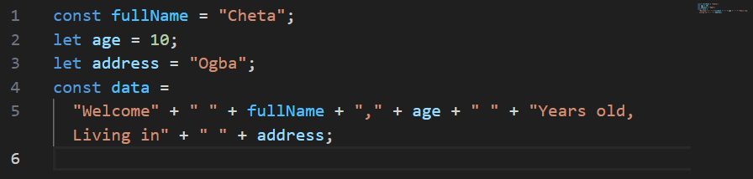
String Concatenation
This is done using the + operator to combine strings and variables.
It joins strings and variables together to create a new and longer string value
It requires adding spacing manually
Syntax:

Slide 5
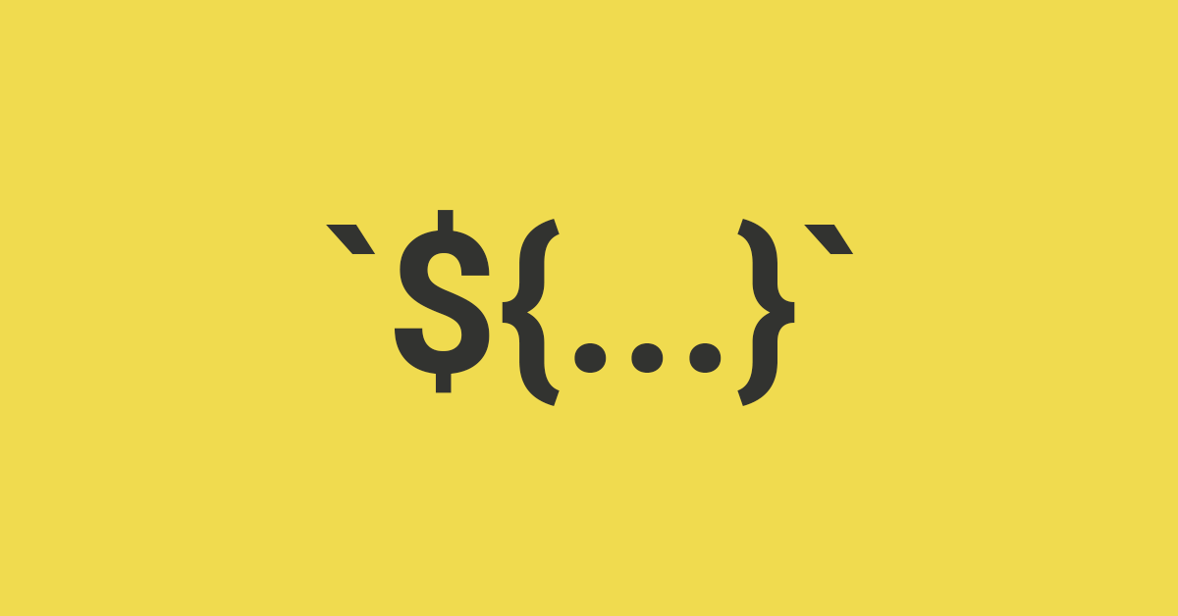
Template Literals
Template literals were introduced in JavaScript ES6 (2015).
It allows inserting variables and expressions directly inside strings.
It provides a cleaner and more readable way to create expressions.
Template literals also allow multi-line strings without using special characters: \n

Slide 6
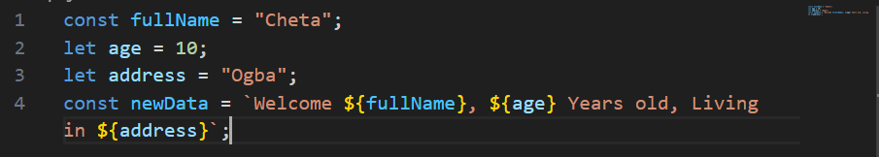
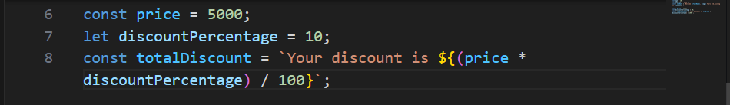
Template Literals Syntax
Backticks (`) to define the string.
Dollar sign and curly braces ${} to insert expressions.

Slide 7
Difference Between String Concatenation and Template Literals
String Concatenation | Template Literals
It uses the + operator to combine strings and create expressions | This uses backticks(`) and dollar sign with curly braces to create expressions
Difficult to read with multiple variables and expressions | Easier to read and creates cleaner code
Requires /n to create multi line strings | Does not require additional characters for multi line strings

Slide 8
Why Template Literals Are Better for Beginners
Easier way to write expressions involving strings and variables
It creates cleaner and more maintainable syntax
Shorter and less error-prone code
A modern standard in JavaScript

Slide 9
THANK YOU!
I HOPE YOU ENJOYED THE PRESENTATION FOR #TEAMEAGLE GENGG 🦅

